Slide 1

Customer Shopping Behavior Analysis
Uncovering spending patterns, customer segments, and product preferences from 3,900 transactions to guide strategic decisions.

Slide 2
Dataset at a Glance
3,900 Rows
Demographics
18 columns of transactional data
Age, Gender, Location, Subscription Status
Purchase Details
Behavior
Category, Amount, Season, Size, Color
Discounts, Frequency, Ratings, Shipping
37 missing values in Review Rating — imputed using category median.

Slide 3

Data Preparation in Python
01
Load & Explore
Imported with pandas; used df.info() and .describe()
02
Clean & Standardize
Imputed missing ratings; renamed columns to snake_case
03
Feature Engineering
Created age_group and purchase_frequency_days columns
04
Load to PostgreSQL
Dropped redundant promo_code_used; pushed to database

Slide 4
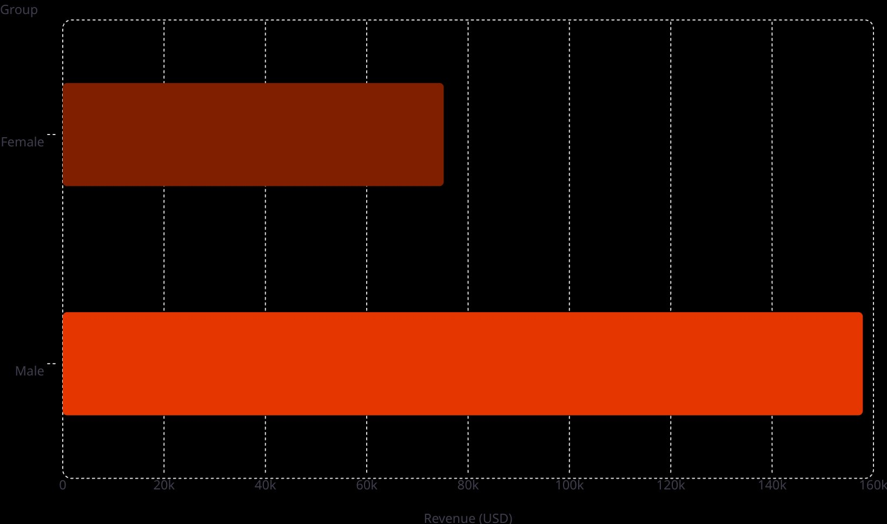
Revenue & Spending Insights
Shipping Type vs. Spend
75.2k
Shipping
Avg. Spend
Standard
$58.46
Express
$60.48
158k
Express users spend slightly more — a signal for targeted upsell campaigns.

Slide 5

Subscriber vs. Non-Subscriber
1,053
2,847
27%
Subscribers
Non-Subscribers
Subscription Rate
Avg spend: $59.49 | Revenue: $62,645
Avg spend: $59.87 | Revenue: $170,436
Significant growth opportunity
Non-subscribers generate 2.7× more total revenue — boosting subscriptions is a key lever.

Slide 6

Customer Segmentation
2.13%
Repeat Buyers & Subscriptions
17.97%
Customers with >5 purchases:
Status
Count
Loyal·79.9%
·79.9%
·
Returning·17.97%
·17.97%
·
New·2.13%
Non-Subscriber
2,518
·2.13%
·
Subscriber
958
79.9%
Loyal customers dominate — yet most are still non-subscribers.

Slide 7
Top Products & Discount Dependency
Top 5 by Rating
Most Discount-Dependent
Product
Avg Rating
Product
Discount Rate
Gloves
3.86
Hat
50.00%
Sandals
3.84
Sneakers
49.66%
Boots
3.82
Coat
49.07%
Hat
3.80
Sweater
48.17%
Skirt
3.78
Pants
47.37%

Slide 8
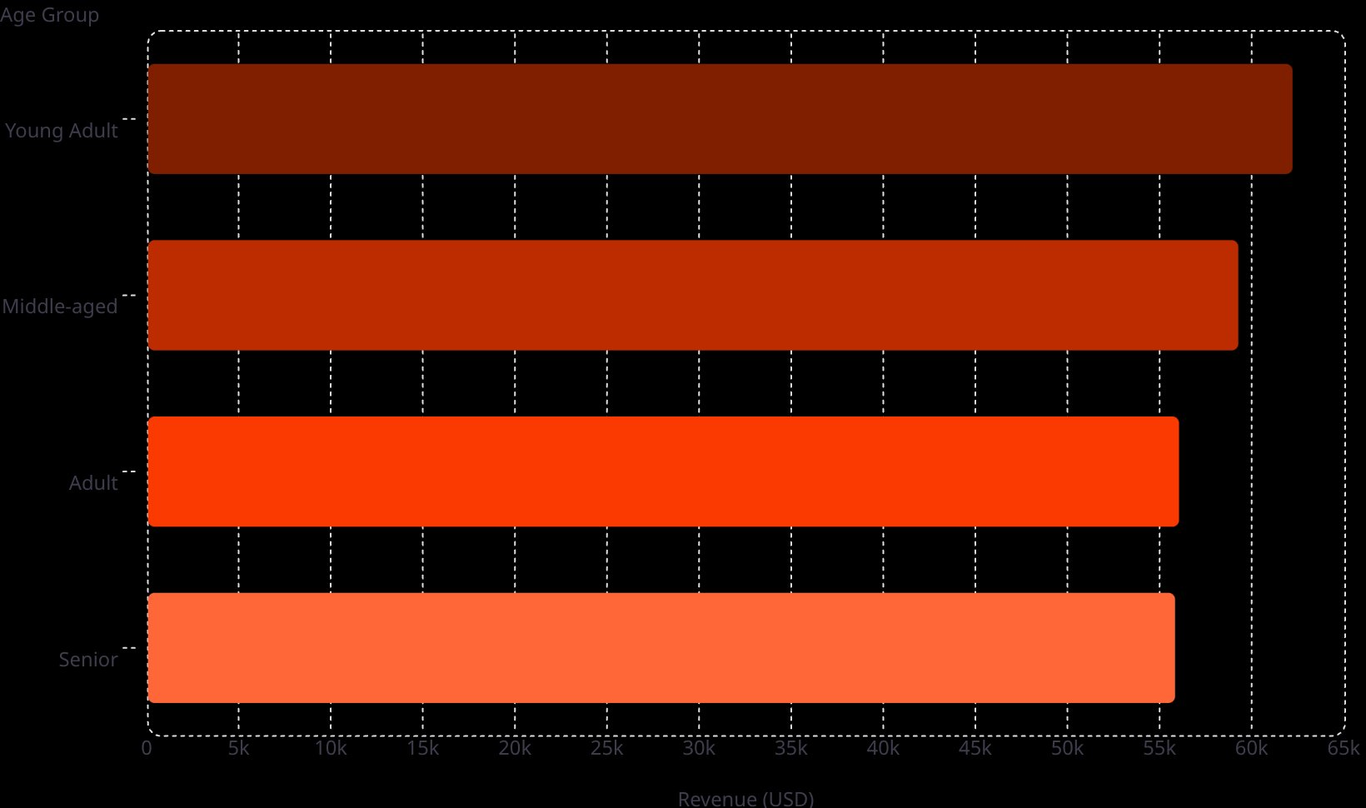
Revenue by Age Group
Top 3 Products per Category
62.1k
Category
Top Products
59.2k
Accessories
Jewelry, Sunglasses, Belt
56k
Clothing
Blouse, Pants, Shirt
Footwear
Sandals, Shoes, Sneakers
55.8k
Outerwear
Jacket, Coat

Slide 9
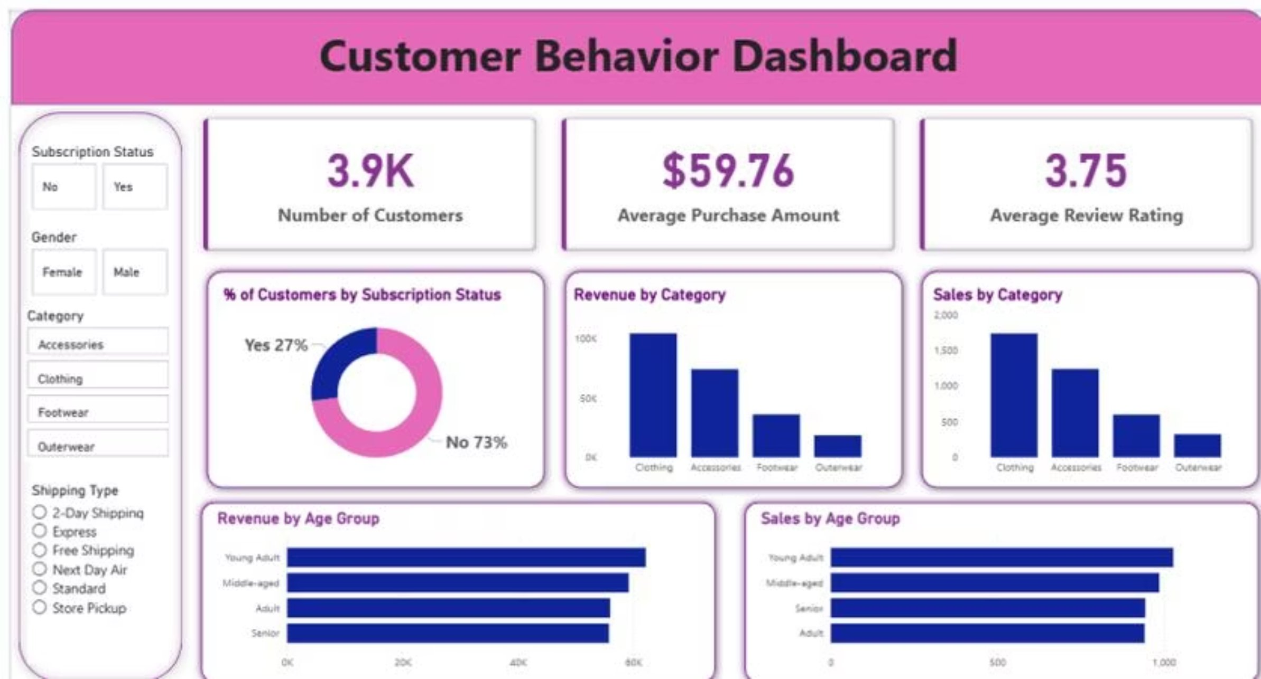
Power BI Dashboard
3.9K
$59.76
3.75
Customers
Avg Purchase
Avg Rating

Slide 10

Business Recommendations
Boost Subscriptions
Loyalty Programs
Review Discount Policy
Promote exclusive subscriber benefits
Reward repeat buyers to grow the Loyal segment
Balance sales boosts with margin control
Targeted Marketing
Product Positioning
Focus on high-revenue age groups and express-shipping users
Highlight top-rated and best-selling items in campaigns

